Slide 1

COAL Chapter 4
Week 3,4 Shoaib Rauf
Courtesy: Dr. Muhammad Nouman Durrani

Slide 2
Data Transfer Instructions
• Operand Types x86 instruction formats:
[label:] mnemonic [operands][ ; comment ]
Because the number of operands may vary, we can further subdivide the formats to have zero,
one, two, or three operands. Here, we omit the label and comment fields for clarity:
mnemonic
mnemonic [ destination]
mnemonic [ destination],[source] mnemonic [destination],[source-1],[source-2]
To give added flexibility to the instruction set, x86 assembly language uses different types of instruction operands. The following are the easiest to use:
• Immediate—uses a numeric literal expression •Register—uses a named register in the CPU
• Memory—references a memory location

Slide 3
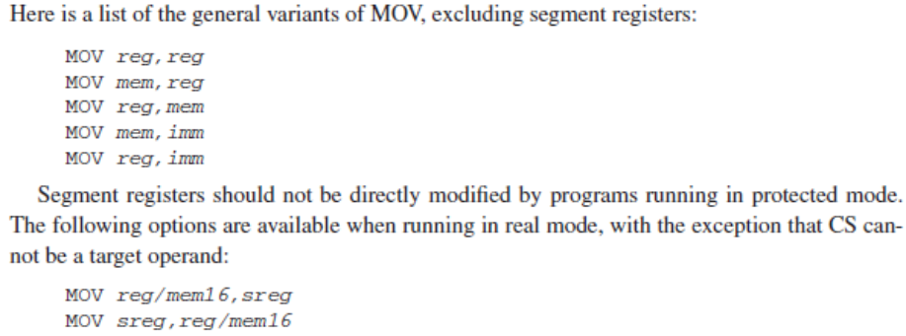
MOV Instruction
• The MOV instruction copies data from a source operand to a destination operand.
• Its basic format shows that the first operand is the destination and the second operand is the source:
MOV destination, source

Slide 4
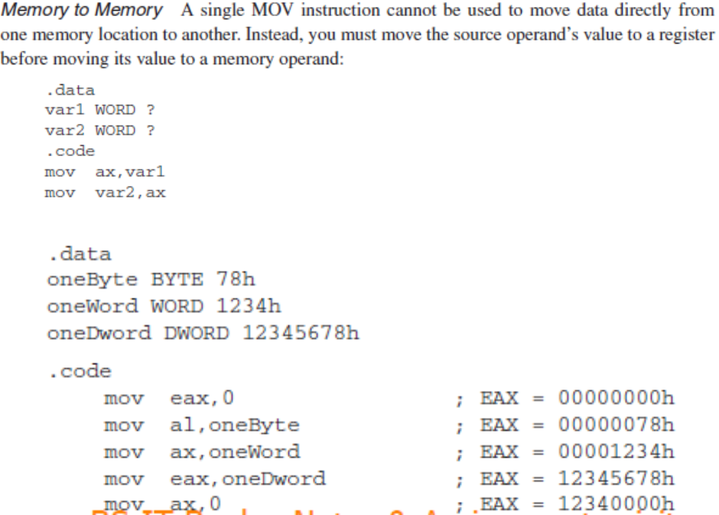
Overlapping Values:

Slide 5
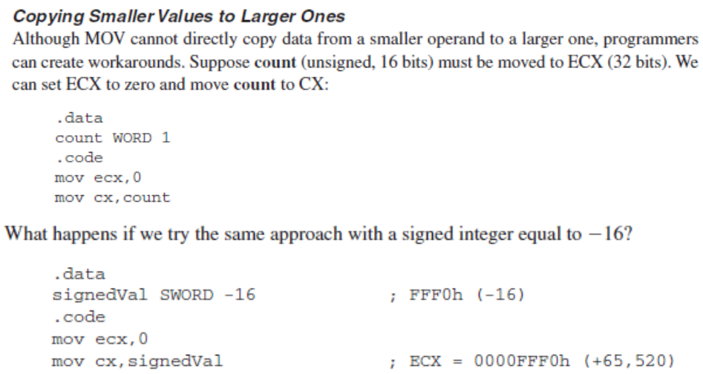
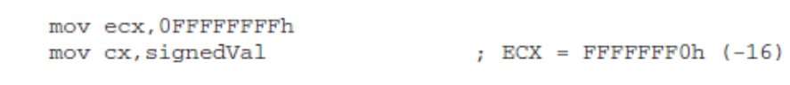
Solution:

Slide 6
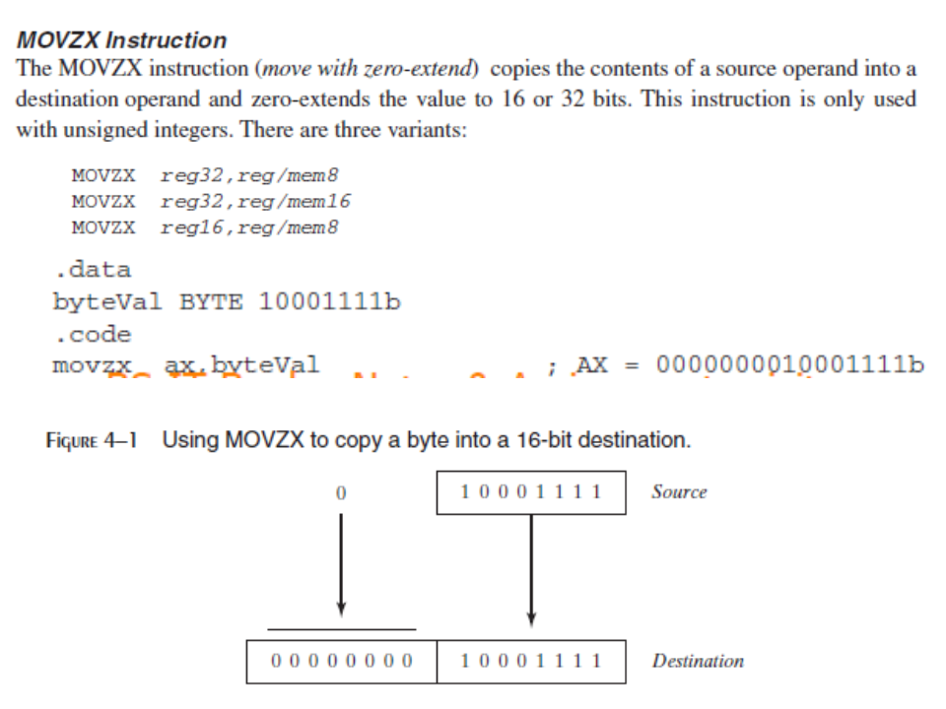

Slide 7
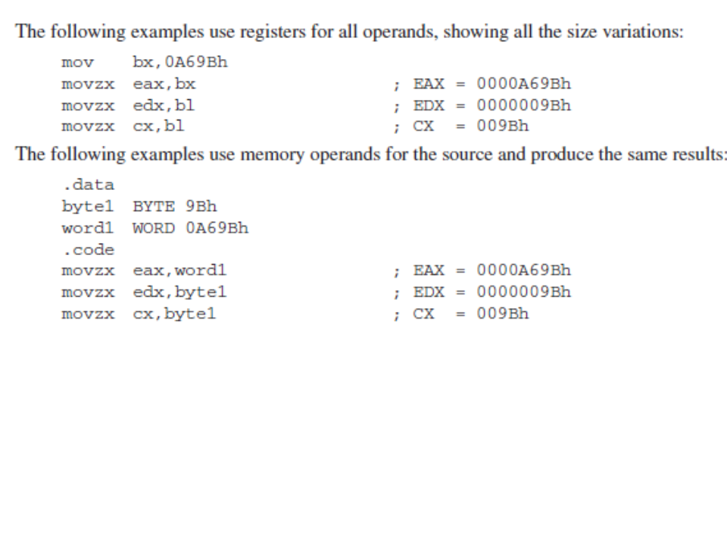

Slide 8
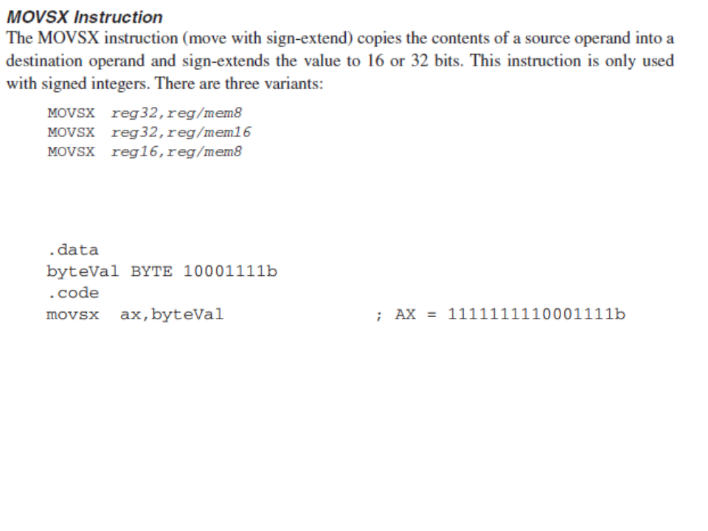

Slide 9
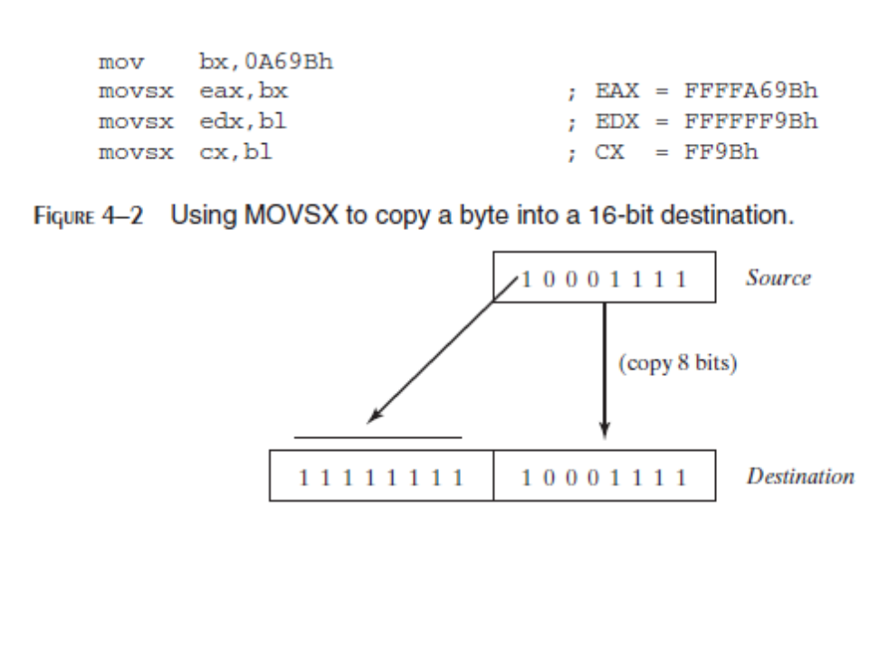

Slide 10
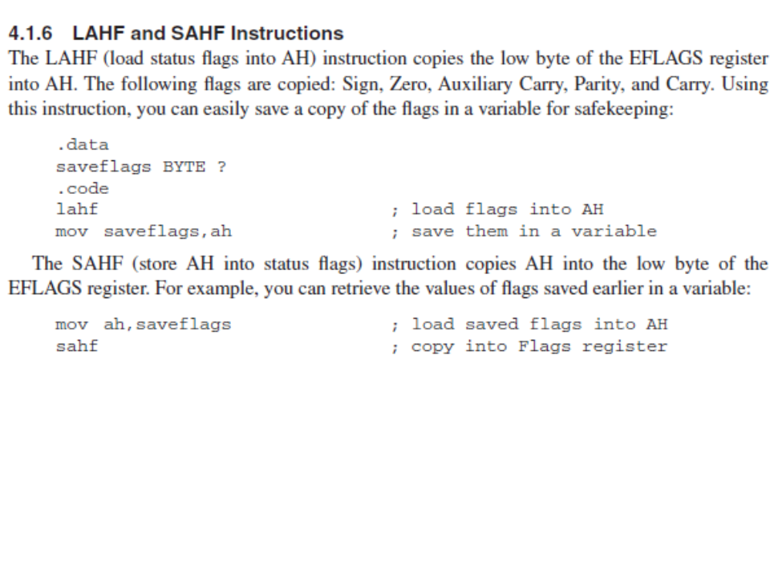

Slide 11
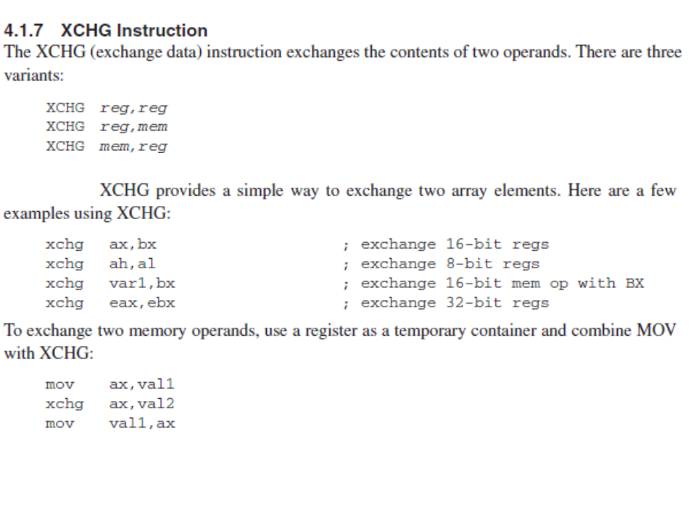

Slide 12
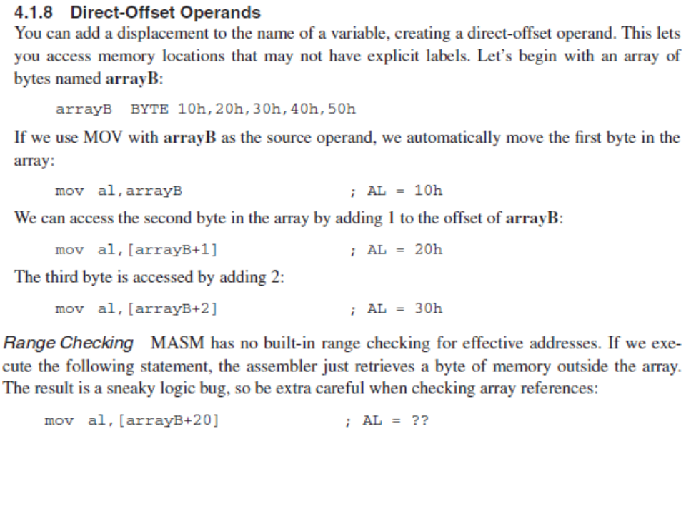

Slide 13
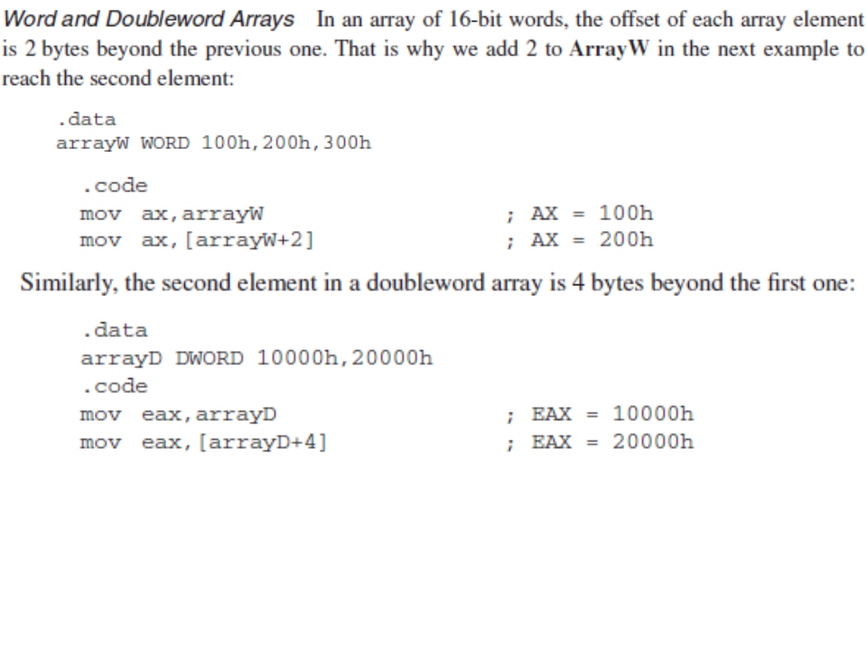

Slide 14
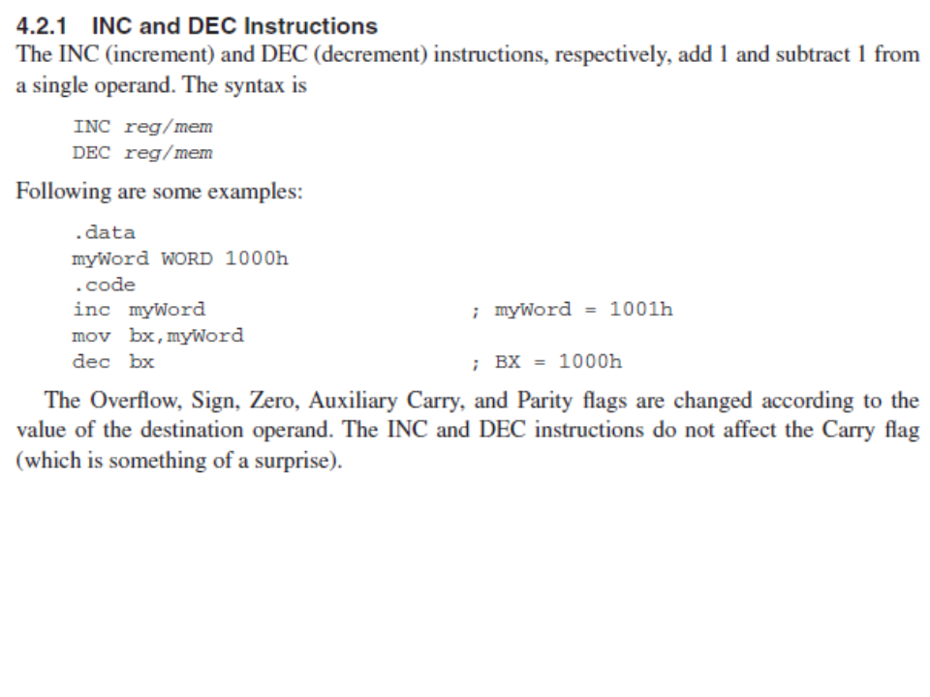

Slide 15
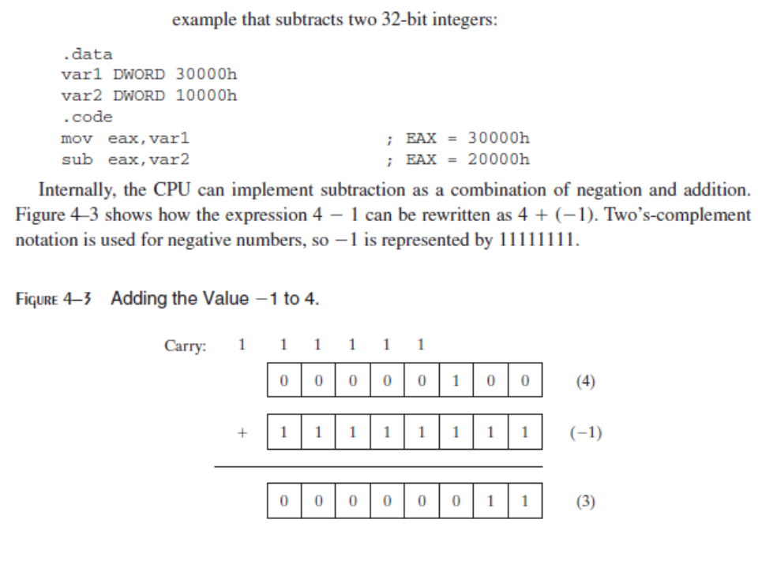

Slide 16
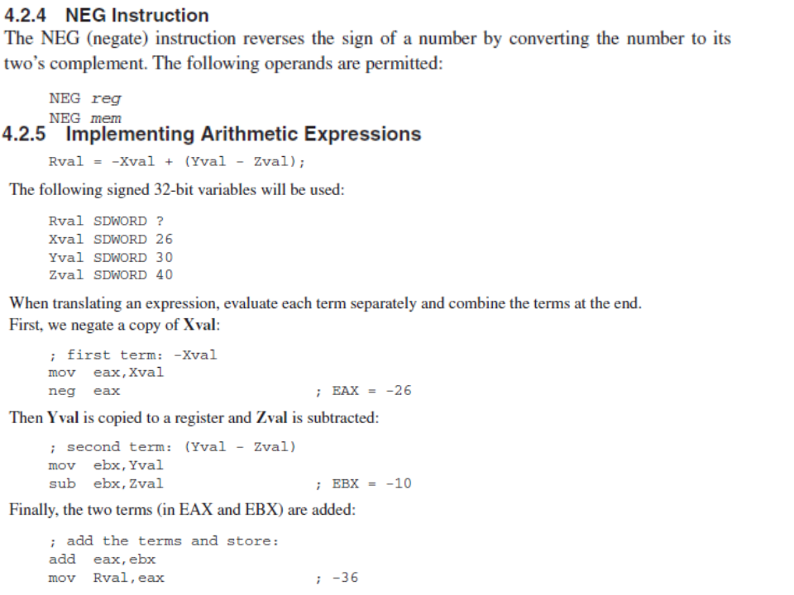

Slide 17
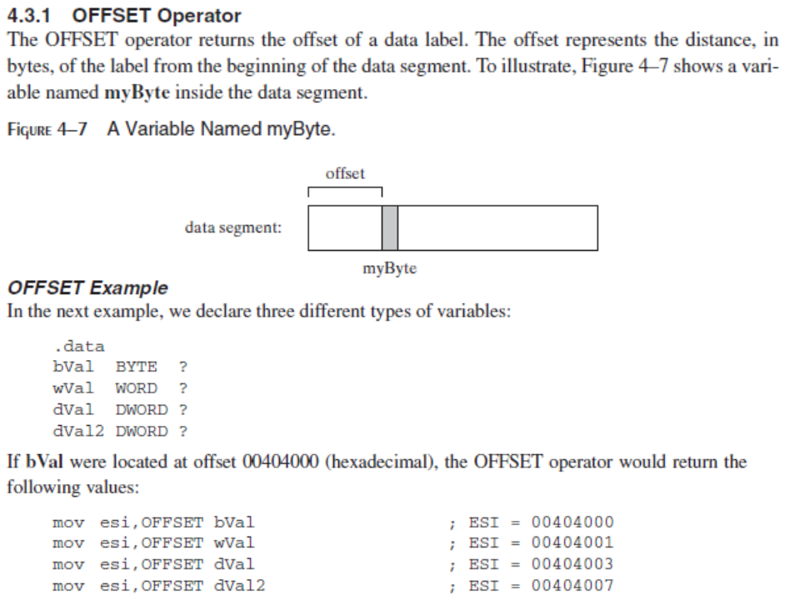

Slide 18
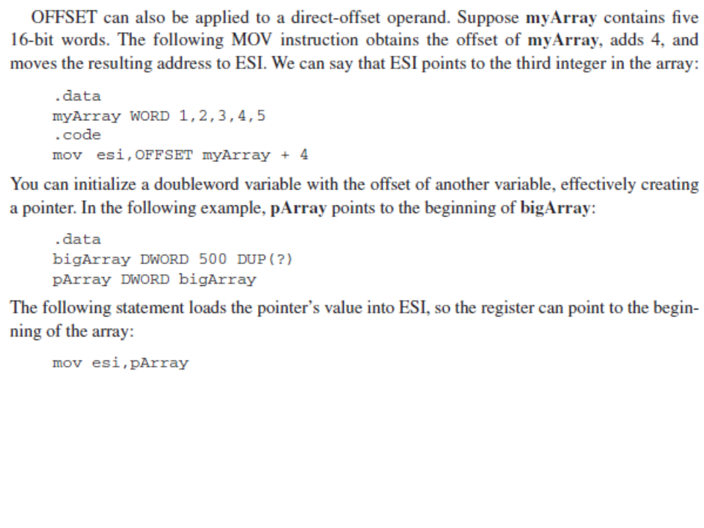

Slide 19
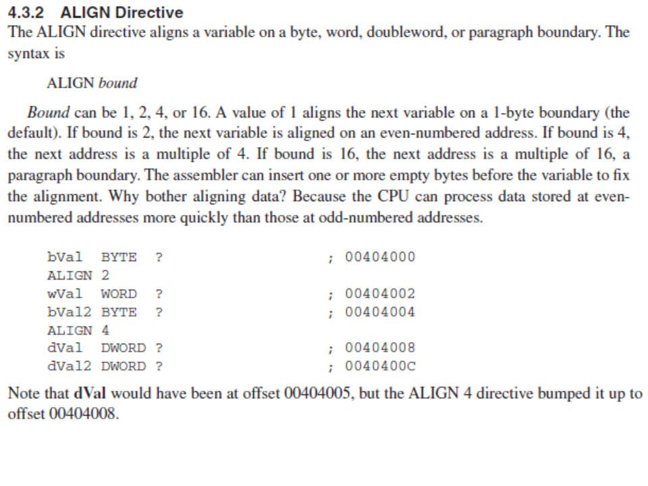

Slide 20
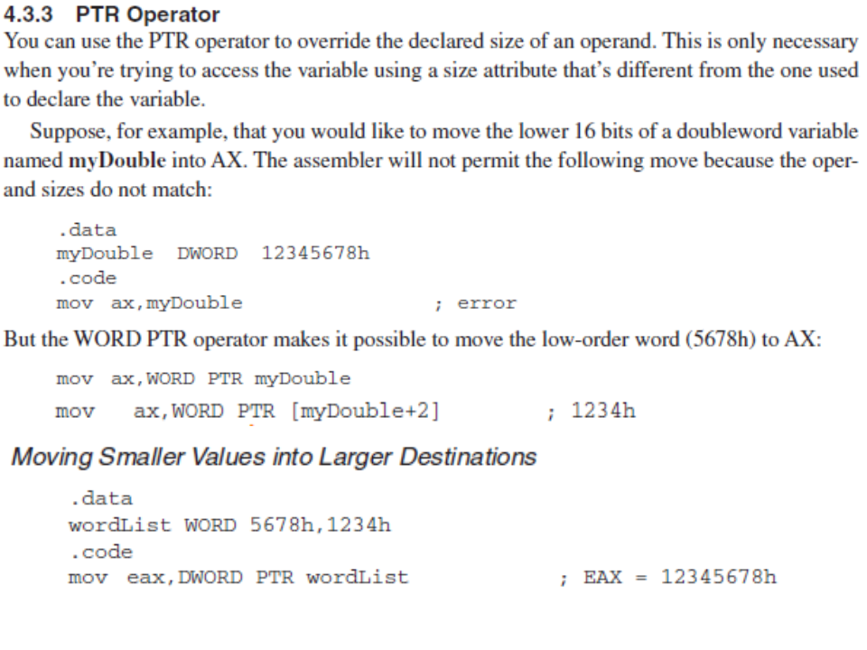

Slide 21
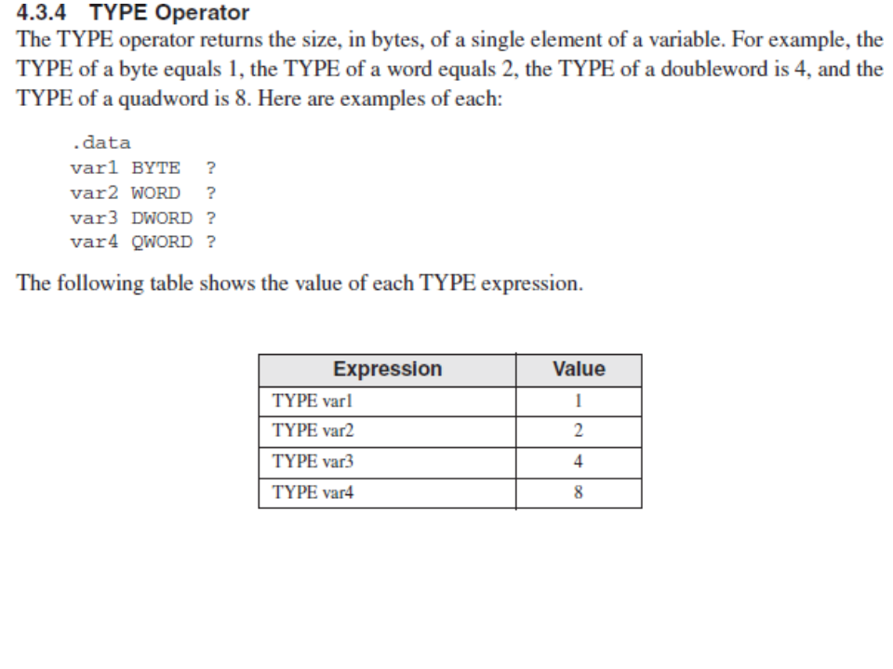

Slide 22
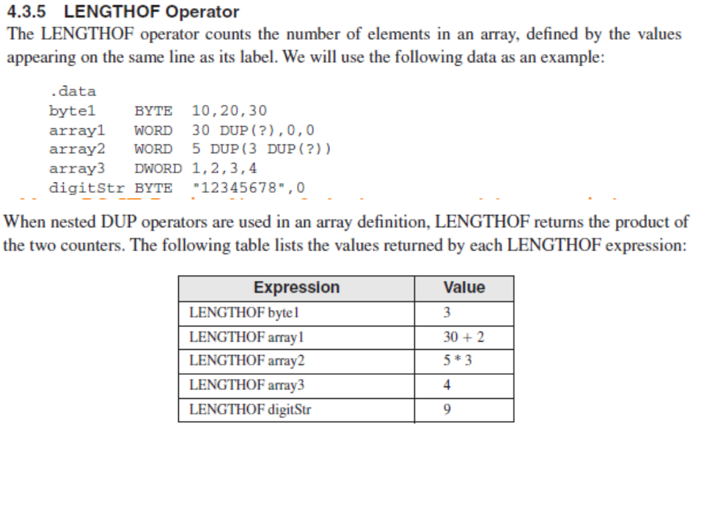

Slide 23
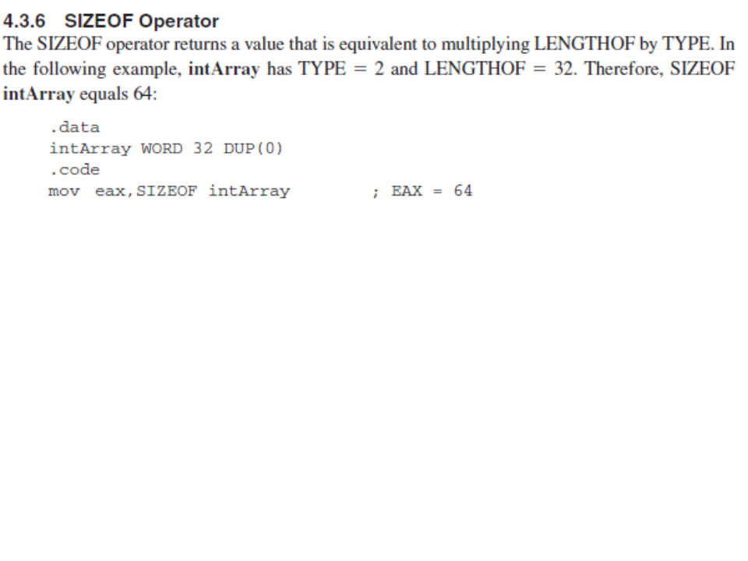

Slide 24
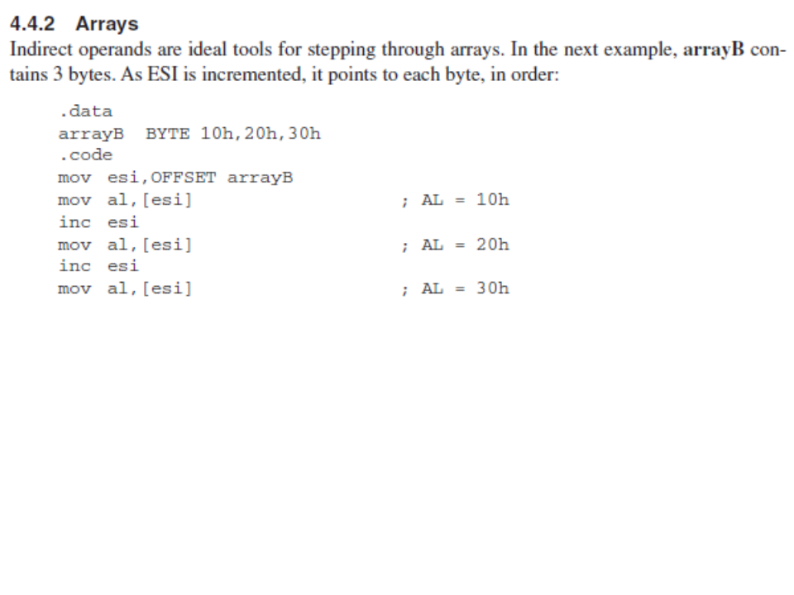

Slide 25
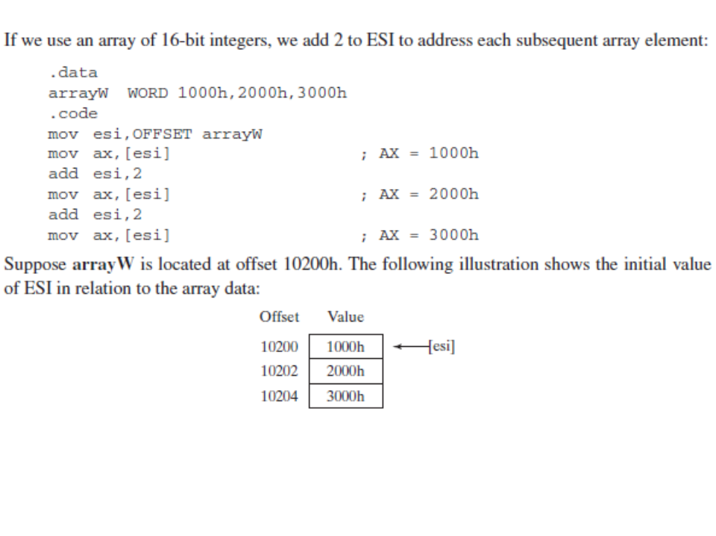

Slide 26
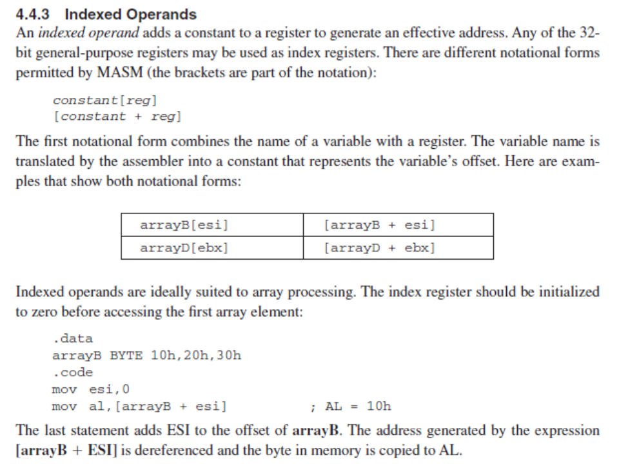

Slide 27
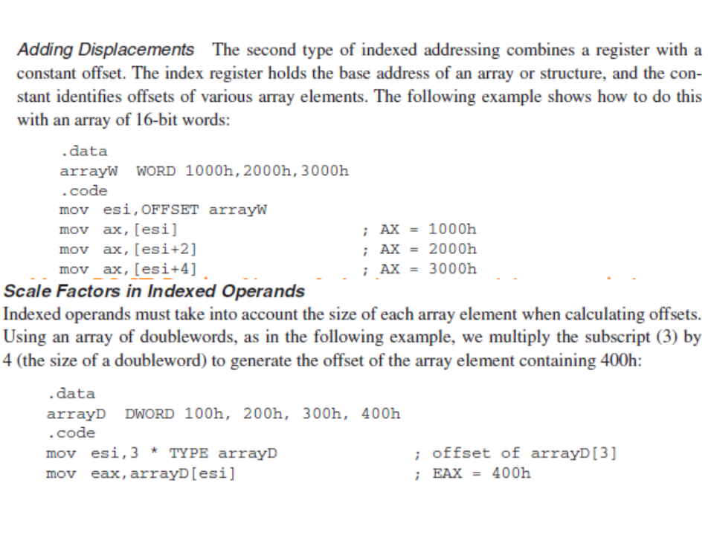

Slide 28
